Slide 1
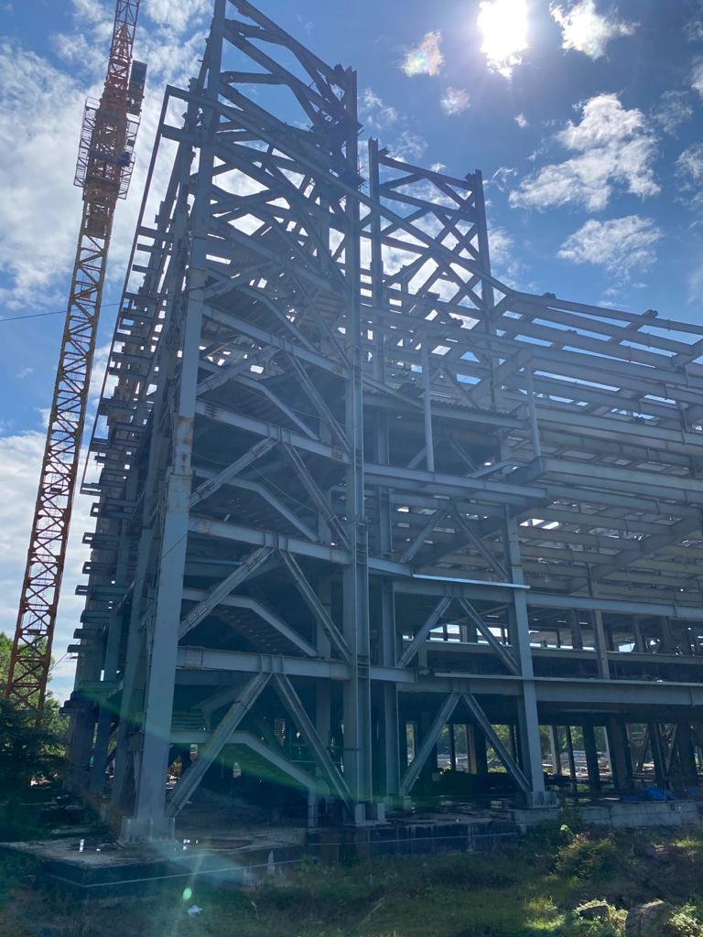
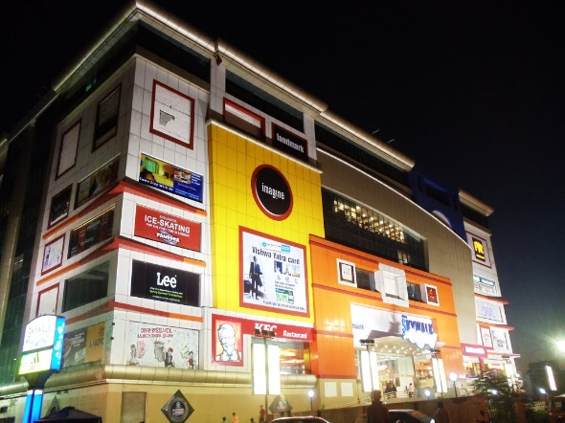

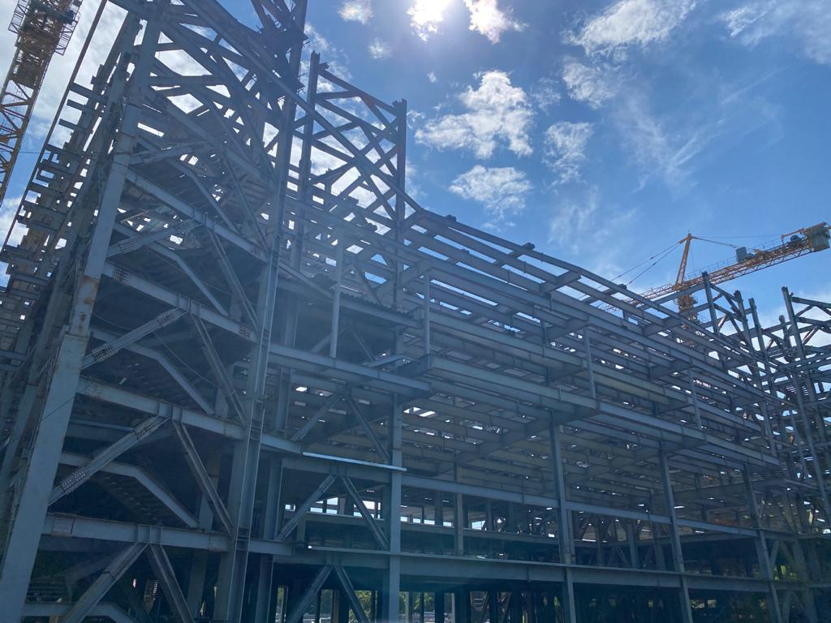
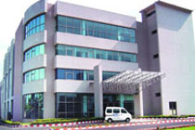
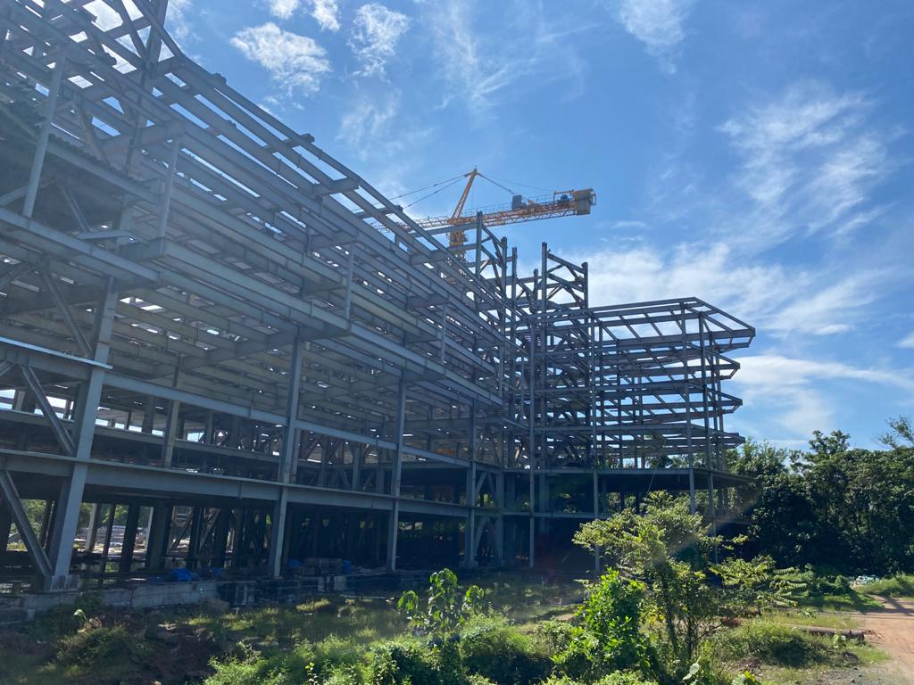
DESCON
ASSOCIATIES
“We assist organizations in doing the right projects—those with strategic alignment that make the best use of your time, talent, and budget—and doing them right.
RAMESH SELVAM
0000000000
00000000000
+91 9176199099
Contact.descon@gmail.com
www.margiestravel.com

Slide 2
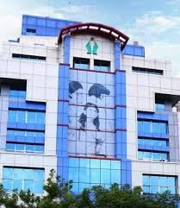
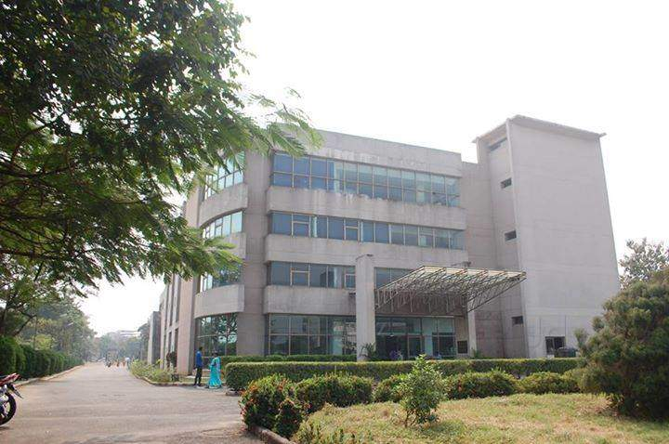
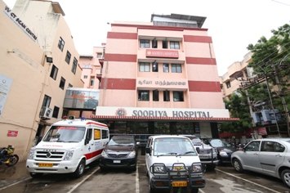
Expertise in handling cross functional stakeholders – staff, contractors, clients, government authorities, CXOs Overseas experience in Guam islands for Sumitomo Constructions – Resorts, Golf course bridges and roads
Ramesh Selvam.R. B.E., F.I.E
SERVICES OFFERED
ARCHITECTURAL
INTERIOR
MEP
LANDSCAPING
PROJECT BUGETING
PROJECT SCHEDULEING
CRISIS MANGEMENT
PROJECT CONTROL
Expertise in Surveying, Budgeting, Planning, Designing, Estimation, Scheduling, Value engineering, Cost control, Tender preparation & floating, managing construction permits and contractors, Planning, Monitoring and control of contractors and Vendors & End to End Project Management including Design proof review
Expertise in all aspects of Construction Management EPC (Engineering, Procurement Construction, Survey, Site Supervision) SCM (Supply Chain Management - material and labour resource optimization), Quality Plan – assurance and Control safety plan – Health and Environment Compliance. Testing, Transition Management till commissioning and after commissioning.

Slide 3
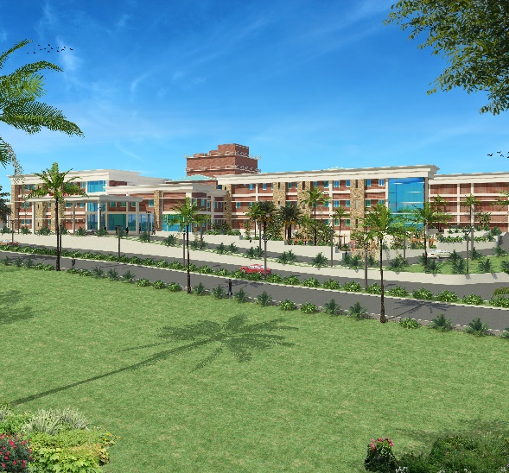
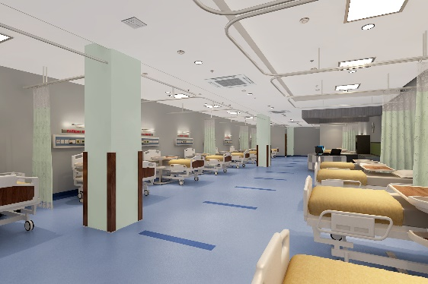
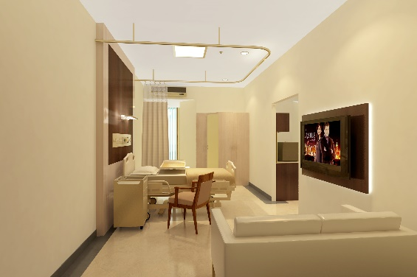
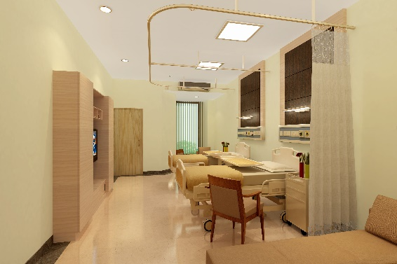
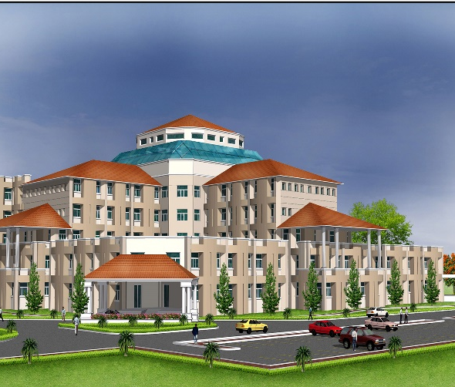
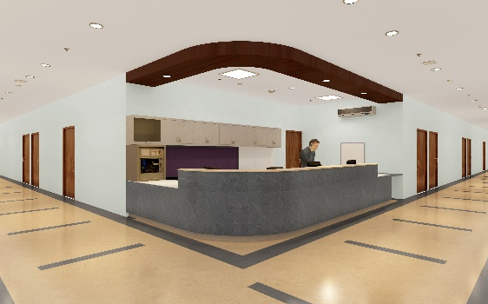
Opportunity is everywhere. The key is to develop the vision to see it.”
Anonymous
Kavitha.M. B.Arch
with experience in the planning , design and construction of diverse project renovation ,major and minor architectural projects such as institutional, recreational, healthcare facilities and residential
Extensive back ground in all infrastructures directing all project phrases from designs through completion of constructions, coordinating the efforts of contractors and engineering services consultants and all governments’ agencies

